Slide 1
Meeting 20-05-2022

Slide 2
Contents
Image + PR model issues
CNN linear model
Testing models
Loss functions
Paper discussion

Slide 3
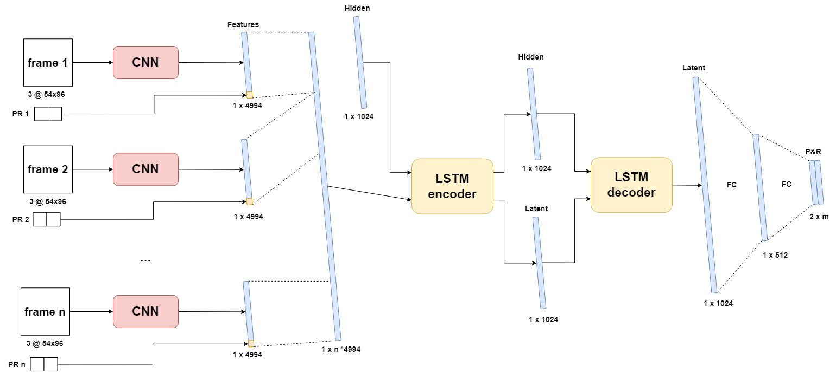
Image + PR model

Slide 4
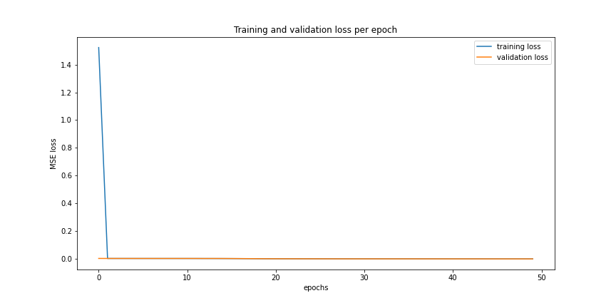
CNN linear
New model without LSTM -> lower latency
Inconsistent training
Anomaly in first epoch

Slide 5
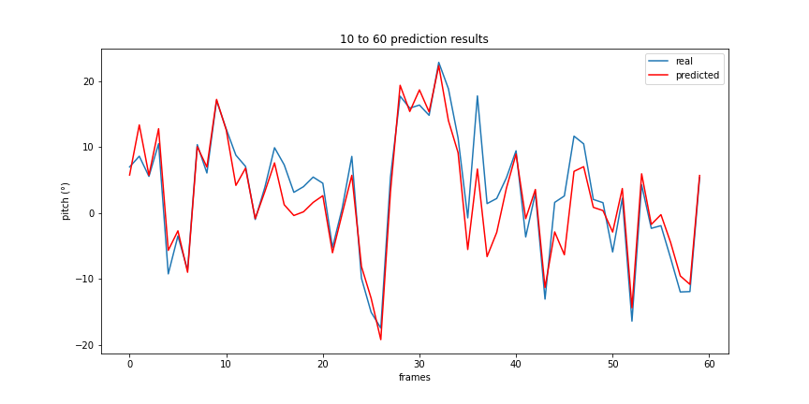
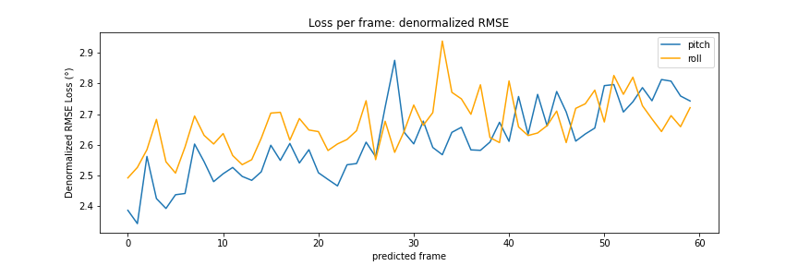
CNN linear
Good results
Average error of 2.67°
Less spread between P and R error
Increasing trend

Slide 6
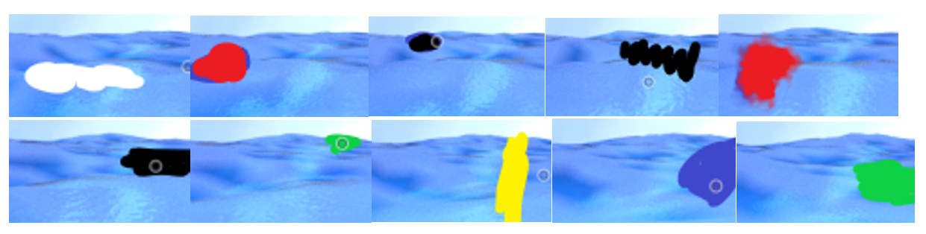
Testing
Abstractions to .py files
Easier loading and testing of trained models
Inference time
Performance with ink blots

Slide 7
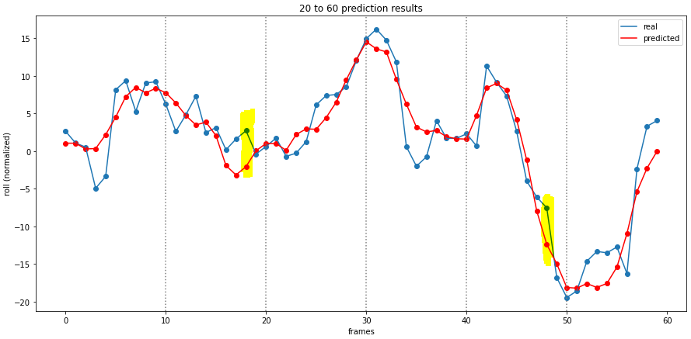
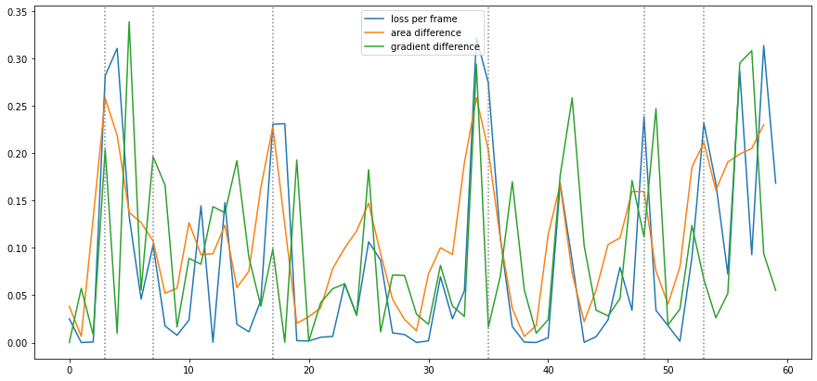
Loss functions
No trend similarity measures MSE loss
Dynamic time dilation, DTW
Gradient difference

Slide 8
Paper discussion
Good in word or latex necessary?
Fonts, themes
reference style: APA
Conference paper
Extra results in appendix
Other methods
Effect of other parameters

Slide 9
Feedback
Focus more on the results
Remove parts on real data
Pollux P902
Operation window for drone (depends on drone, wind)
LR failures, other failures
Data visualization
DPLR one of the best methods with given sensor and its data

